Slide 1
Design of parallel algorithms
Matrix operations
J. Porras

Slide 2
Contents
Matrices and their basic operations
Mapping of matrices onto processors
Matrix transposition
Matrix-vector multiplication
Matrix-matrix multiplication
Solving linear equations

Slide 3
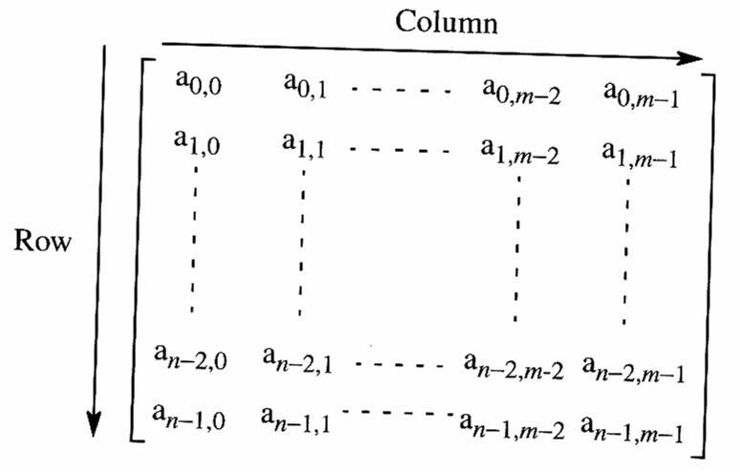
Matrices
Matrix is a two dimensional array of numbers
  n X m matrix has n rows and m columns
Basic operations
  Transpose
  Addition
  Multiplication

Slide 4
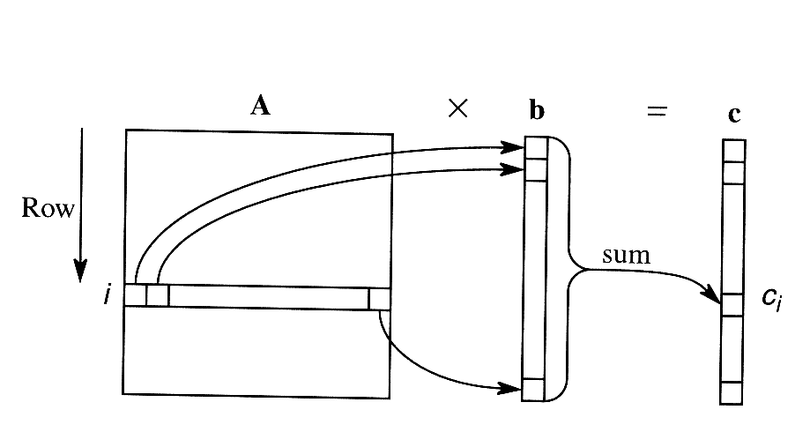
Matrix * vector

Slide 5
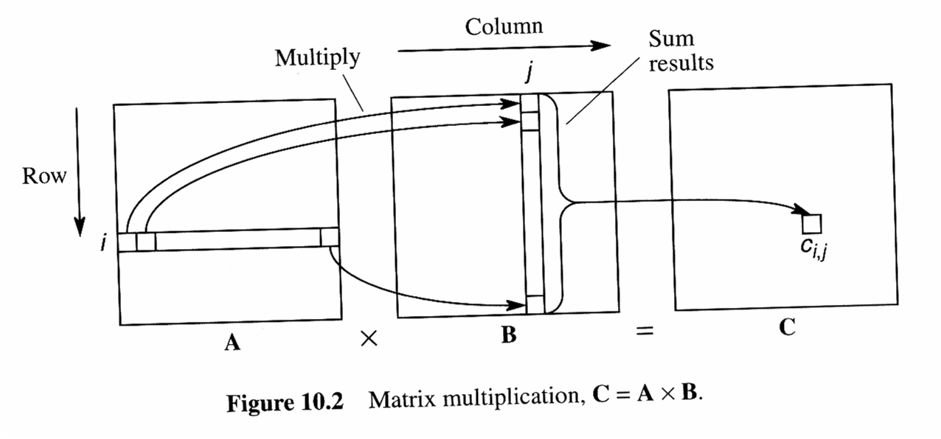
Matrix * matrix

Slide 6
Sequential approach
for (i=0;i<n;i++) {
for (j=0;j<n;j++) {
c[i][j] = 0;
for (k=0;k<n;k++) {
c[i][j] = c[i][j] + a[i][k] *b[k][j];
}
}
}
n³ multiplications and n³ additions => O(n³)

Slide 7
Parallelization of matrix operations
Classified into two groups
dense
  non or only few zero entries
sparse
  mostly zero entries
  can be executed faster than dense matrices

Slide 8
Mapping matrices onto processors
In order to process a matrix in parallel we must partition it
This is done by assigning parts of the matrix onto different processors
  Partitioning affects the performance
  Need to find the suitable data-mapping

Slide 9
Mapping matrices onto processors
striped partitioning
  column/rowwise
  block-striped, cyclic-striped, block-cyclic-striped
checkerboard partitioning
  block-checkerboard
  cyclic-checkerboard
  block-cyclic-checkerboard

Slide 10
Striped partitioning
Matrix is divided into groups of complete rows or columns and each processor is assigned one such group
  Block of cyclic striped or a hybrid
May use maximum of n processors

Slide 11
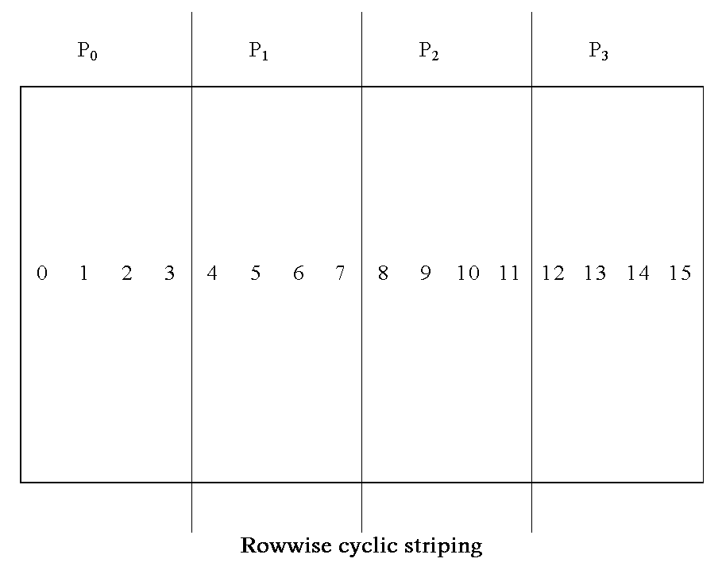

Slide 12
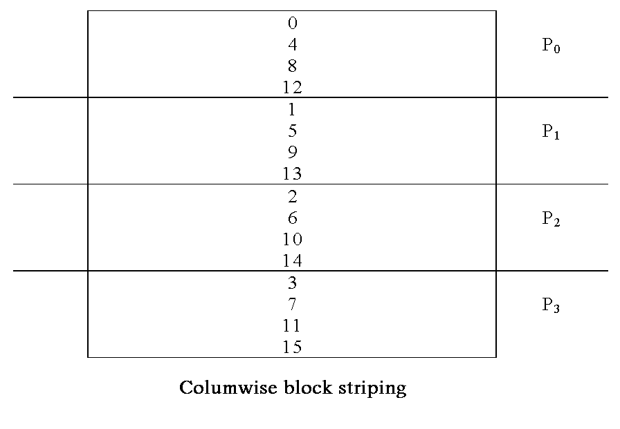

Slide 13
Striped partitioning
block-striped
  Rows/columns are divided in such a way that processor P0 gets first n/p rows/columns, P2 the next …
cyclic-striped
  Rows/columns are divided by using wraparound approach.
  If p=4 and n = 16
    P0 = 1,5,9,13, P1 = 2,6,10,14, …

Slide 14
Striped partitioning
block-cyclic-striped
  Matrix is divided into blocks of q rows and the blocks have been divided among processors in a cyclic manner
  DRAW a picture of this !

Slide 15
Checkerboard partitioning
Matrix is divided into square or rectangular block/submatrices that are distributed among processors
Processors do NOT have any common rows/columns
May use maximum of n² processors

Slide 16
Checkerboard partitioning
checkerboard partitioned matrix maps naturally onto a 2d mesh
  block-checkerboard
  cyclic-checkerboard
  block-cycle-checkerboard

Slide 17
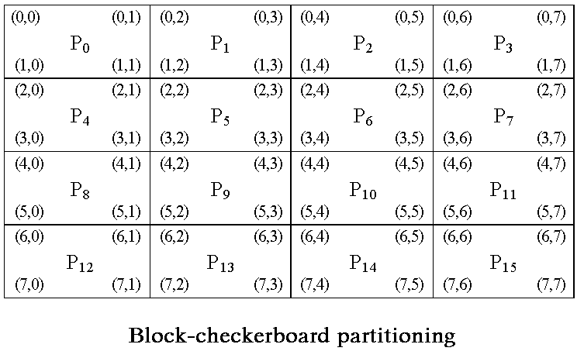

Slide 18
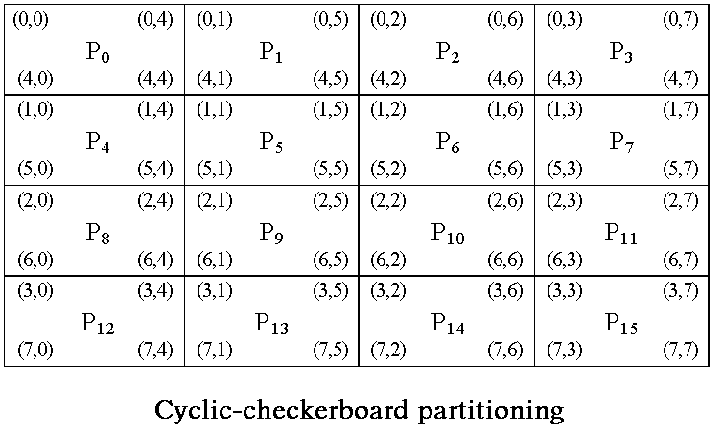

Slide 19
Matrix transposition
Transposition A^{T}of a matrix A is given
  A^{T}[i,j]=A[j,i], for 0 < i,j < n
Execution time
  Assumptions : one time step / one exchange
  Result (n²-n)/2
  Complexity O(n²)

Slide 20
Matrix transposition
Checkerboard Partitioning - mesh
Mesh
  Element below the diagonal must move up to the diagonal and then right to the correct place
  Elements above diagonal must move down and left

Slide 21
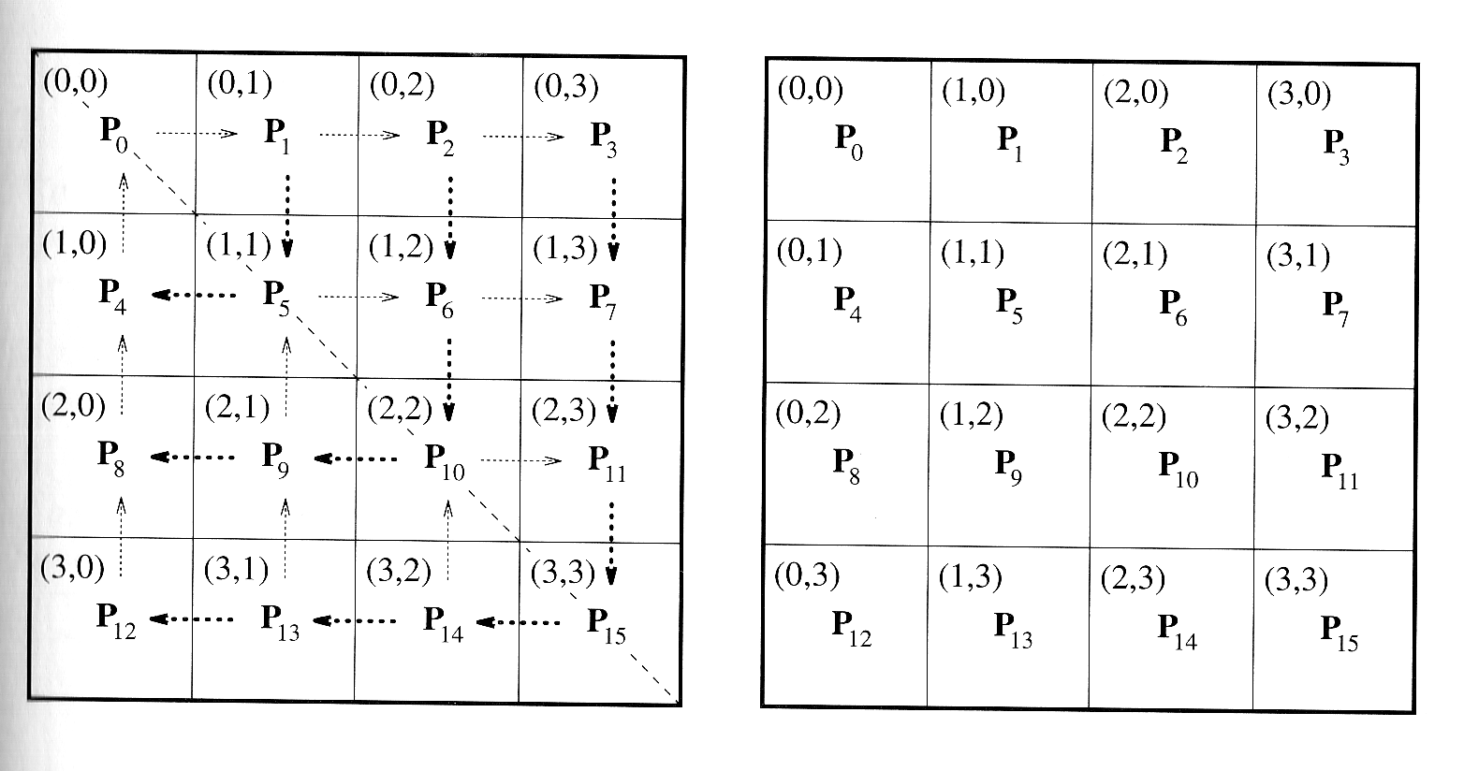
Matrix transposition on mesh

Slide 22
Matrix transposition checkerboard partitioning - mesh
Transposition is computed in two phases:
  Square matrices are treated as indivisible units and 2D array of blocks is transposed (requires interprocessor communication)
  Blocks are transposed locally (if p<n²)

Slide 23
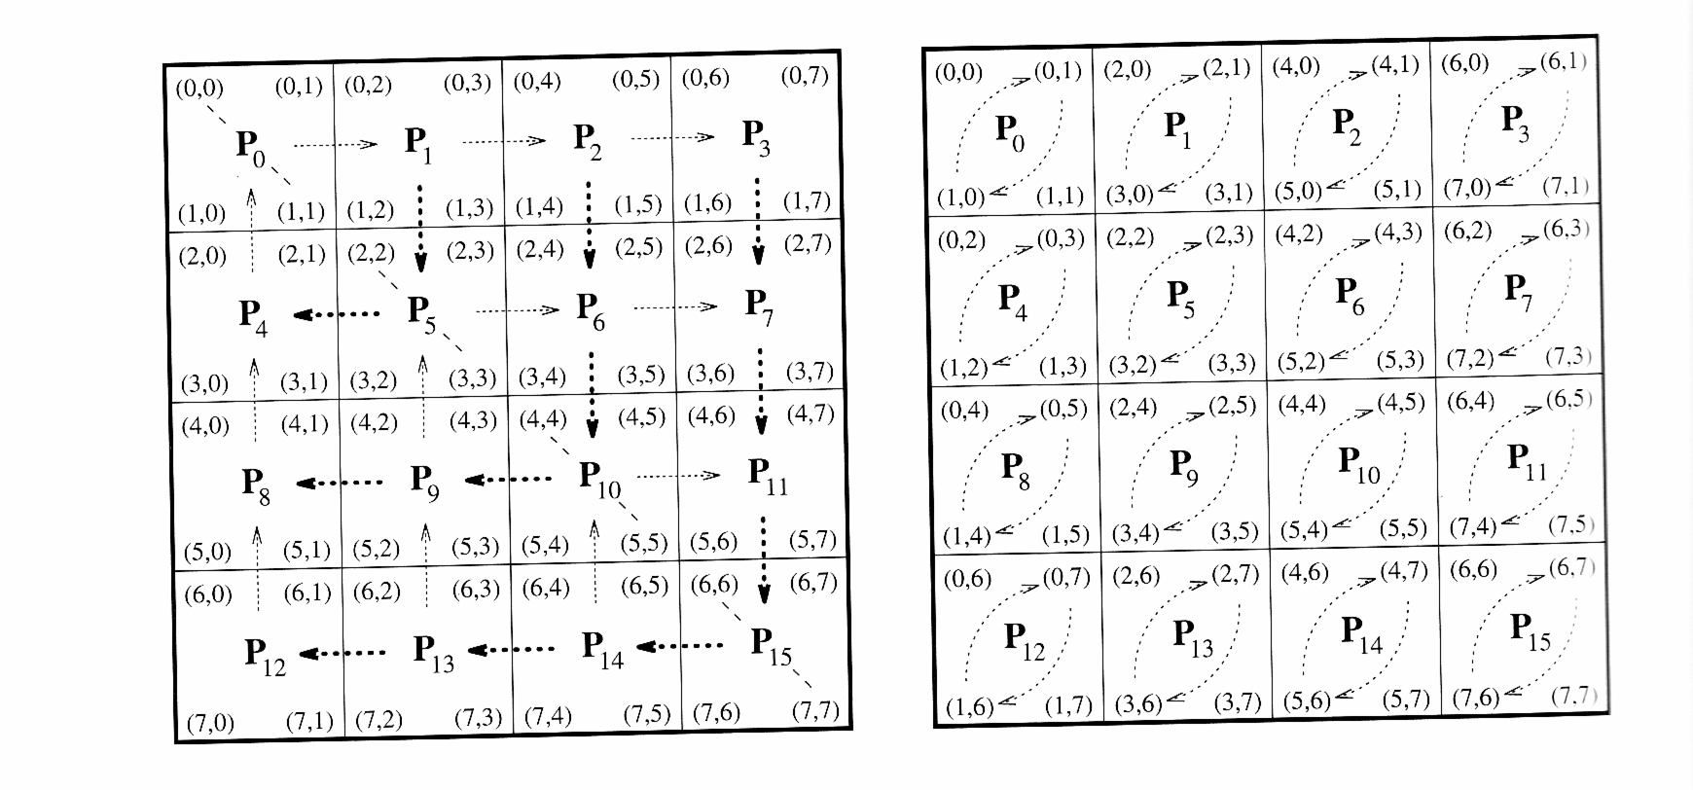
Matrix transposition

Slide 24



Matrix transposition checkerboard partitioning - mesh
Execution time
  Elements on upper right and lower left position travel the longest distances (2√p)
  Each block contains n²/p elements
    t_{s} + t_{w}n²/p time / link
    2(t_{s} + t_{w}n²/p) √p total time

Slide 25
Matrix transposition
Checkerboard Partitioning - mesh
  Assume one time step / local exchange
    n²/2p for transposing n√p * n√p submatrix
T_{p} = n²/2p + 2t_{s} √p + 2t_{w}n²/ √p
Cost = n²/2 + 2t_{s}p^{3/2} + 2t_{w}n²√p
NOT cost optimal !

Slide 26
Matrix transposition
Checkerboard Partitioning - hypercube
Recursive approach (RTA)
  In each step processor pairs
    exchange top-right and bottom-left blocks
    compute transpose internally
  Each step splits the problem into one fourth of the original size

Slide 27
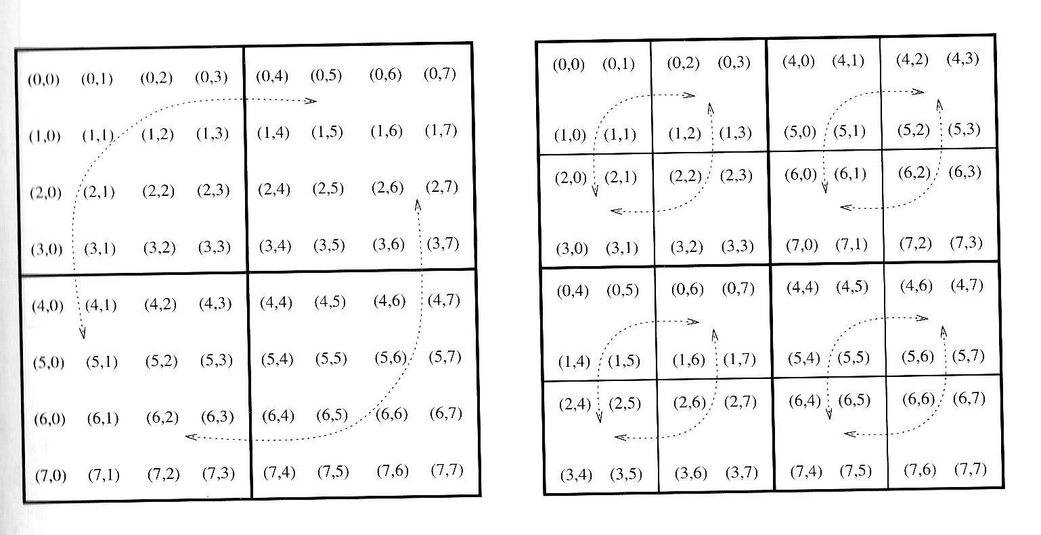
Recursive transposition

Slide 28
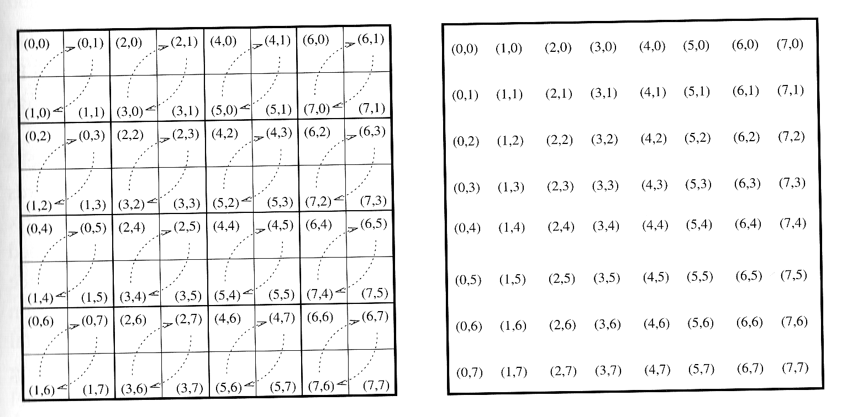
Recursive transposition

Slide 29
Matrix transposition
Checkerboard Partitioning - hypercube
Runtime
  In (log P)/2 steps the matrix is divided into blocks of size n√p * n√p => (n²/p)
  Communication: 2(t_{s} + t_{w}n²/p) / step
  log p steps => (t_{s} + t_{w}n²/p)log p time
  n²/2p for local transposition
  T_{p} = n²/2p + (t_{s} + t_{w}n²/p) log p
  NOT cost optimal !

Slide 30
Matrix transposition
Striped Partitioning
n x n matrix mapped onto n prosessors
  Each processor contains one row
  P_{i} contains elements [i, 0], [i ,1], ..., [i, n-1]
After transpose the elements [i ,0] are in processor p₀ and elements [i, 1] in p₁ etc
In general:
  element [i,j] is located in P_{i} in the beginning, but is moved into P_{j}

Slide 31
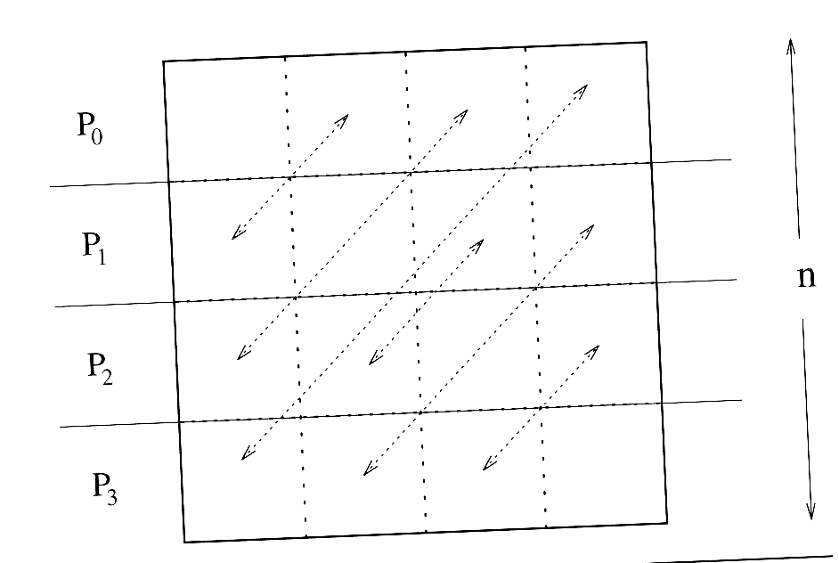

Slide 32
Matrix transposition
Striped Partitioning
If p processors and p ≤ n
  n/p rows / processor
  n/p * n/p blocks and all-to-all personalized communication
  Internal transposition of the exchanged blocks
DROW picture !

Slide 33
Matrix transposition
Striped Partitioning
Runtime
  Assume one time step fo exchange
  One block can be transposed in n²/2p² time
  Each processor contains p blocks => n²/2p time
  …
  Cost-optimal in hypercube with cut-through routing
    T_{p} = n²/2p + t_{s}(p-1) + t_{w}n²/p + 1/2)t_{h}plog p

